Slide 1
Dealing with Loops: Loop Analysis and Optimizations

Slide 2
The FORTRAN DO Loop
Subscript (Loop Index)
Lower Loop Limit
Upper Loop Limit
Step
DO I = 1, N, 2
A(I) = B(I) + 3
B(I) = B(I) + 1
END DO
Loop Body

Slide 3
The Generalized Tightly Nested Loop
L₁: DO I₁ = P₁, Q₁, R₁
L₂: DO I₂ = P₂, Q₂, R₂
. . .
L_{m}: DO I_{m} = P_{m}, Q_{m}, R_{m}
S₁(I₁, I₂, …, I_{m})
…
S_{n}(I₁, I₂, …, I_{m})
END DO
. . .
END DO
END DO

Slide 4
The Generalized Tightly Nested Loop
Each S_{i} is a statement (some computation) involving the loop indices
There are no statement in between the DO’s and END DO’s
All computation occur in the ‘kernel’ of the loop
The loops are normalized if their lower bounds all start from 1

Slide 5
Iteration Vector
Let i = (I₁, I₂, …, I_{m}) be a vector of integers
An iteration vector is an assignment of integers to i that are within all the respective loop bounds
An iteration vector uniquely identify a specific iteration of the loop

Slide 6
Lexicographical Ordering
For two iteration vectors, i = (i₁, i₂, …, i_{m}) and j = (j₁, j₂, …, j_{m}) we define the relationship i ≻_{k} j if and only if for 1 ≤ k ≤ m,
i₁ = j₁, i₂ = j₂, …, i_{k-1} = j_{k-1} and i_{k} > j_{k}
If i ≻_{k} j or i = j, then we say i _{k} j
The lexicographical order ≻ is defined by
i ≻ j ≡ i ≻_{k} j for some k in 1 ≤ k ≤ m

Slide 7
Lexicographically Non-negative
An iteration vectors, i = (i₁, i₂, …, i_{m}) is lexicographically non-negative if i  0
In other words, there exist 1 ≤ k ≤ m, such that
i₁ = 0, i₂ = 0, …, i_{k-1} = 0 and i_{k} ≥ 0
It is lexicographically positive if i ≻ 0
Lexicographical ordering is related that execution ordering for sequential execution.
If i ≻ j then iteration i is executed after iteration j

Slide 8
The Iteration Dependence Graph
J
8
DO I = 1, 8
DO J = I+1, 8
A(I+1,J) = … A(I, J-1)…
END DO
END DO
7
6
5
4
3
2
1
1
2
3
4
5
6
7
8
I

Slide 9
Important Note
Unlike registers, we cannot get rid of memory output and anti-dependences by renaming

Slide 10
Execution Instances of CFG nodes
Consider CFG node X with d enclosing reducible
(single-entry) intervals numbered 1…d from outermost
to innermost. X[i₁,i₂,…,i_{d}] stands for the execution
instance of X corresponding to the i_{k}^{th} iteration of
interval k, ∀1 ≤ k ≤ d.
If interval k is a normalized DO loop (i.e. with initial
value and increment both = 1), then i_{k} will equal the
value of its index variable.

Slide 11
Data Dependence Direction Vectors: Definition
The direction vectors of a data dependence, S₁ → S₂,
is a set of d-tuples { Ψ = (Ψ₁, Ψ₂,…,Ψ_{d}) }, such that
1. d is the number of intervals that enclose both
S₁ and S₂, and
2. each Ψ_{k} is one of { “<“, “=“, “>”, “≤”, “≥”, “≠”, “*” }
and
3. for any pair of execution instances of S₁ and S₂ , say
S₁ [ i₁,…,i_{d} ] and S₂ [ j₁,…, j_{d} ], such that
S₁ [ i₁,…,i_{d} ] → S₂ [ j₁,…, j_{d} ], we must have i_{k} Ψ_{j} j_{k} ∀1 ≤k ≤ d for at least one direction vector, Ψ.

Slide 12
Loop-independent and Loop-carried Data Dependences
A data dependence is said to be loop-independent if it has at least one direction vector, ψ , such that each element of ψ contains “=“.
Loop-independent dependences constrain the reordering that an be performed within a loop iteration.
A data dependence is said to be loop-carried if it has at least one direction vector, ψ, such that at least one element of ψ contains a direction other than ”=“.

Slide 13
Loop-independent and Loop-carried Data Dependences (Contd.)
Loop-carried dependences constrain the reordering
that can be performed across loop iterations.
A data dependence can be both loop-independent
and loop-carried.

Slide 14
Examples of One-dimensional Loop- independent Loop-carried dependences
Loop-independent: Loop-carried:
------------------------- ------------------
DO i = 1, n DO i = 1, n
X(i) = X(i) + 1 X(i) = X(i-1) + i
END DO END DO
Dir. vec. for X is (=) Dir. vec. for X is (<)
X(1) = X(2)= X(1)=_ X(2)=_ X(3)=_
| | . . . \ \ \ . . .
=X(1) =X(2) =X(0) \_ =X(1) \_ =X(2) \_

Slide 15
Extending Direction Vectors to Distance Values
A direction vector, Ψ = (Ψ₁, Ψ₂,…,Ψ_{d}), identifies
equality/inequality conditions under which the
dependence holds, i_{k} Ψ_{k} j_{k} ∀1 ≤ k ≤ d.
If, in addition, we know that the k^{th} dependence
condition only applies the case when i_{k} +Δ = j_{k}, for
some constant Δ, then we can be more precise and set
Ψ_{k} = Δ, a distance value.
If Ψ can contain both direction and distance values, we
refer to it more generally as a dependence vector.

Slide 16
Example of Two-dimensional Loop- independent and Loop-carried dependences
DO 10 i = 2, n-1
DO 10 j = 2, n-1
X(i,j) = X(i-1,j) + Y (i,j)
A(i) = A(i) + j
10 if ( Y(i,j) .eq. 0 ) Z = Z + i*j
Flow dep. from X(i,j) to X(i-1, j) with dep. vector (1,0)
Flow dep. from A(i)_{def} to A(i)_{use} with dep. vector (=,<) (can be refined to distance vector (0,1))
Anti dep. from A(i)_{use} to A(i)_{def} with dep. vector (=,≤_ (can be refined to distance vectors {(0,0), (0,1)})
Output dep. from A(i)_{def} to itself with dep. Vector (=,<) (can be refined to distance vector (0,1))

Slide 17
Example of 2-D Loop-indep. And Loop-carried dependences (Contd.)
Flow dep. from Z_{def} to Z_{use} with dep. vectors {(=,<),
(<,*)] (set of all 2-D lexicographically positive vectors)
Anti dep. from Z_{use} to Z_{def} with dep. Vectors
{(=,=), (=,<), (<,*)} (set of all 2-D lexicographically non-
negative vectors)
Output dep. from Z_{def} to Z_{def} with dep. Vectors
{(=,<),(<,*)} (set of all 2-D lexicographically positive
vectors)
The dependence vectors for Z represent worst-case
constraints and prevent any iteration-reordering
transformation from being performed.

Slide 18
Plausible Dependence Vectors
A dependence vector is plausible if and only if it is
lexicographically non-negative. All dependencies in
sequential programs must be plausible (otherwise the
input program would not satisfy its own data
dependencies).
Two-dimensional loop nest:
DO i = 1,…
Do j = 1,…
. . .
Examples of plausible dependence
vectors: (0,1), (1,-1), (1,*)
Examples of implausible dependence
vectors: (0,-1), (-1,0), (*,0)
Iteration Space:
i
(0,-1)
3
[3,1]
[3,2]
[3,3]
(1,-1)
(-1,0)
2
[2,1]
[2,2]
[2,3]
1
[1,1]
[1,2]
[1,3]
(0,1)
j
1
2
3

Slide 19
The Polytope (Polyhedra) Model

Slide 20
The Polytope Model
Basic idea: characterize a perfect nest of r DO-loops as a convex polytope in ℤ^{r} (r-dimension integer) space
Transformation of the polytope ⇔ transformation on the loop nest

Slide 21
Affine Model
We assume: the subscripts in the array accesses inside the loop involves only the loop variable and some constants
Example of non-affine model: subscript involve a variable read from user
Very tough to analyze or be precise
Through constant propagation and other optimizations, affine models usually achievable

Slide 22
An Example
DO I=1, 1000
DO J = 100, 2000
A(3*I+J-5) = …
… = A(6*I+2*j+10)…
END DO
END DO

Slide 23
Integer Programming
Can be cast as integer programming problem with constraints of the form:
All variables involved are integers
Linear Diophantine inequalities

Slide 24
Matrix Notation
The system of equations can be written as matrix equations:
x A ≤ b or A x^{T} ≤ b^{T}
x and b are vectors (single row matrices) of length n and x^{T} and b^{T} are their transpose (single column matrices) and A is a m by n matrix

Slide 25
Distance Vector: Another definition
Let p = (p₁, …, p_{n}) and q = (q₁, …, q_{n}) be two iteration vectors (i.e., p_{i} and q_{i} are all integers within the respective bounds).
Suppose two references S(p) and T(q) are such that T(q) is dependent on S(p), then the distance vector is
d = q - p

Slide 26
An Example
DO I = 1, …
DO J = 1, …
A(I,J) = …
… = … A(I, J-2) …
END DO END DO
Distance vector is (0,2)
Direction vector is (=, <)

Slide 27
Decision Algorithms
Goal: determine whether or not a solution exists to the dependence equations, for the given constraints
GCD test [Towle 1976, Banerjee 1976]
Banerjee’s inequality [Banerjee 1976]
Lambda test [Li, Ye,Zhu 1988]
Rice U. tests
Stanford U. tests
Omega test
...

Slide 28
Types of Tests
Inexact tests: test for independence
Output 1: There is no dependences
Output 2: There may be dependences
Exact tests: test for dependences
Output 1: There is no dependences
Output 2: There are dependences

Slide 29
The GCD Theorem
The above linear Diophatine equations has a solution if and only if the GCD (greatest common divisor) of its coefficients divides b.

Slide 30
The GCD Test
Let A(a₀ + a₁I₁ + … + a_{m}I_{m}) be a variable in statement S and A(b₀ + b₁I₁ + … + b_{m}I_{m}) be a variable in statement T in which A is a 1-D array and I is the index variable. If gcd(a₁, a₂, …, a_{m}, b₁, b₂, …, b_{m}) does not divide (b₀ – a₀) then there is no dependency between S and T caused by A.

Slide 31
Banerjee’s Generalized GCD Test
The above is for 1-D case. For multi-dimensional array, testing one equation at a time won’t work – the equations are simultaneous
We need the Generalized GCD Test

Slide 32
Terminologies
An integer matrix is one in which all the entries are integers
If entries are real, then that’s a real matrix
A unimodular matrix is a integer, square (n by n) matrix whose determinant is ±1
The inverse is guarantee to exist
The inverse of a unimodular matrix is also unimodular

Slide 33
The Echelon Matrix
A m by n matrix, A = (a_{ij}) is an echelon matrix (or in echelon form) if for some integer r, 0 ≤ r < m, the following holds:
The rows 0 to r are non-zero
The rows r + 1 to m - 1 are zero
For all i, 0 ≤ i ≤ r, if a_{ik} is the first non-zero entry in row i, then all entries below that one is zero, i.e. a_{lk} = 0 for all r < l < m

Slide 34
Examples
The following matrices are in Echelon Form

Slide 35
Echelon Reduction
Given any m by n integer matrix, A echelon reduction is the process of computing a m by m unimodular matrix, U, and an m by n echelon matrix, E, such that
U A = E
Achieved by scaling, row substraction and row interchange
Similar to Gaussian Elimination

Slide 36
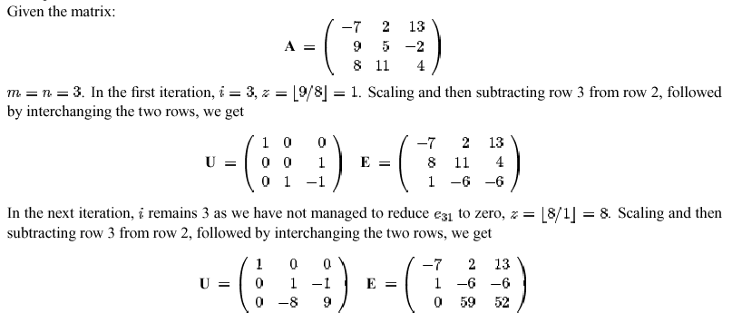
Echelon Reduction: An Example

Slide 37
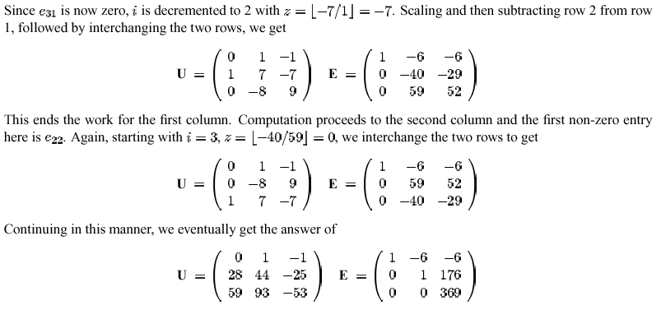
Echelon Reduction: An Example (cont)

Slide 38
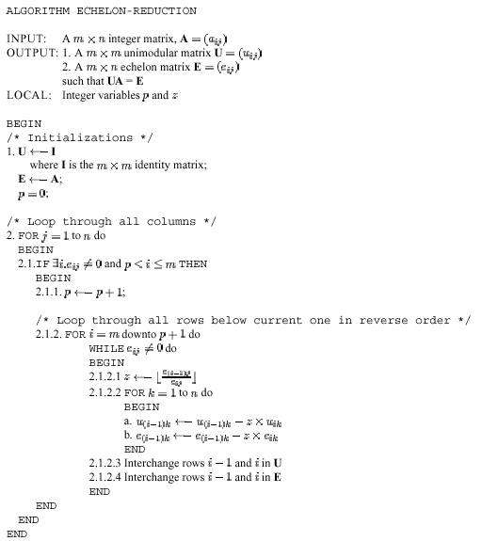
The Algorithm

Slide 39
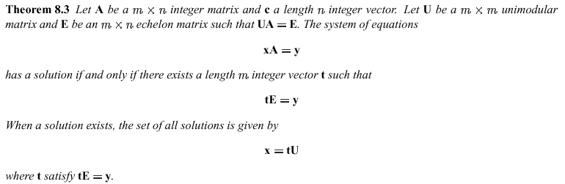
An Important Property of Echelon Reduction

Slide 40
Backward Substitution
We can solve for t in tE = y by backward substitution because E is in echelon form
Analogy: In Gaussian Elimination, we get a upper triangular matrix and use backward substitution to solve

Slide 41
An Example
DO I = 1, 10
DO J = 1, 10
X(2*I+3*J, 2*I+J) = …
… = … X(4*I+2*J+1, 3*I+3*J-4)…
END DO
END DO
S:
T:

Slide 42
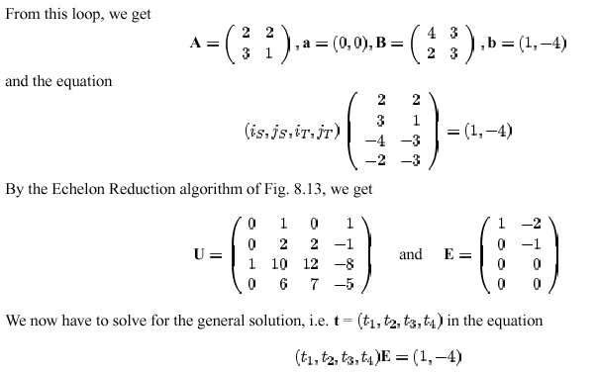
An Example

Slide 43
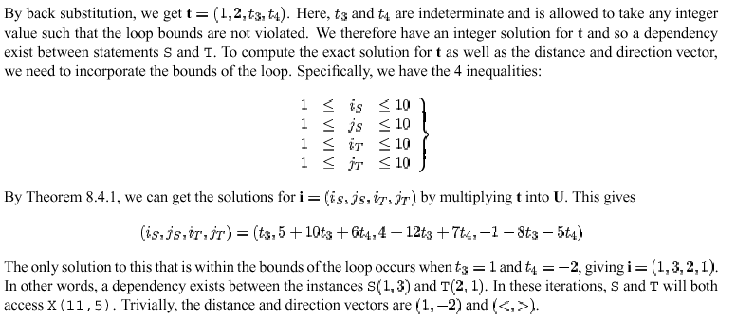
An Example

Slide 44
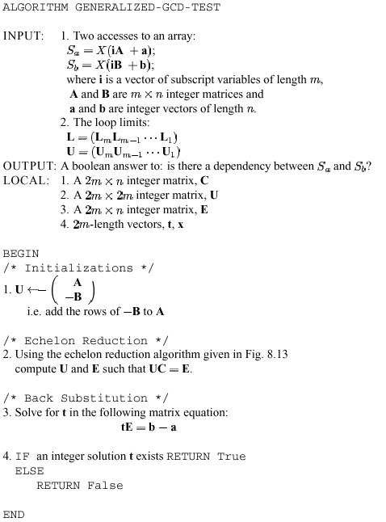
The Generalized GCD Test

Slide 45
Banerjee’s Inequalities
The GCD tests do not take into account the loop bounds
For the simple GCD test, there is a simple way to incorporate loop bounds using Banerjee’s inequalities

Slide 46
Terminology
For a given real number, a, define the following two terms:
a⁺ = max(a, 0)
a⁻ = max(-a, 0)
For a ≥ 0, a⁺ = a, a⁻ = 0
For a < 0, a⁺ = 0, a⁻ = -a

Slide 47
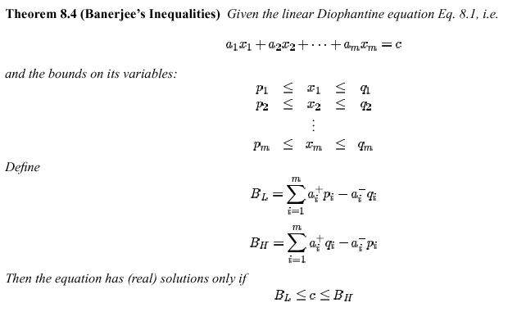
Theorem

Slide 48
The Strategy
Perform the GCD Test to see if there is any dependencies
Solve for the (real) solutions to the Banarjee’s inequalities
If no integer solution exists, then there is no dependency

Slide 49
Extending to multi-dimensional arrays
Consider the generalized tightly nested loop
The bounds on a level k index variable I_{k} may be arithmetic expressions involving all or some of the index variables I_{j}, j < k of the other levels

Slide 50
Rewrite
Rewrite the inequality into
Or in matrix form
p ≤ iP
iQ ≤ q
where i = (I₁, …, I_{m}),

Slide 51
Rewrite (cont)

Slide 52
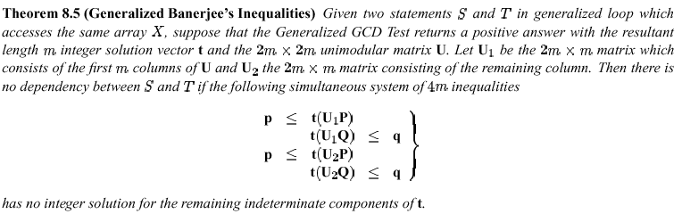
Generalized Banerjee’s Inequalities

Slide 53
Fourier-Motzkin Elimination
A simple technique to determine if real solutions exists for a set of simultaneous inequalities

Slide 54
An Example
Given this set of inequalities
We first transform all to ‘less than or equal’

Slide 55
An Example
We will now eliminate x₂. To do so partition the inequalities according to the sign of the coefficient of x₂, i.e.
and

Slide 56
An Example
Now divide by the corresponding coefficient of x₂. We get
and

Slide 57
An Example
After a bit of manipulation, we get the following set of simultaneous inequalities for x₂
From this we can eliminate x₂ and get

Slide 58
An Example
We now have bounds for x₁
Repeating the process for x₁ we finally have

Slide 59
An Example
This is a non-empty interval – i.e. real solutions exist
Substituting backward, we find that the only real solution is when x₁ = 79/7 and x₂ = -32/7

Slide 60
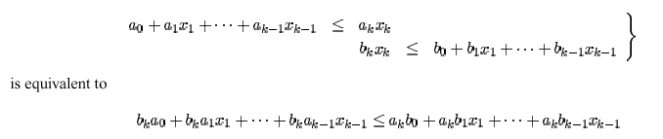
Integer elimination
The existence of real solutions does not guarantee the existence of integer solutions
To do integer elimination, we have to do away with division
We can make use of the following in the elimination step:

Slide 61
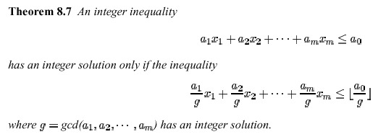
Controlling Scaling
This step has the undesired effect of scaling the coefficient up
Fortunately we can use the following theorem
Note: Division of a number by its gcd will produce only integer results

Slide 62
The Omega Test
The current state of the art: use Fourier-Motzkin elimination with a careful and systematic search for integer solutions
William Pugh. The Omega test: a fast and practical integer programming algorithm for dependence analysis. Communications of the ACM, 35(8):102--114, August 1992

Slide 63
The Omega Test
Normalizing the constraints
Transforming equality constraints into inequality ones
Simplify the set of constraints
Use a modified Fourier-Motzkin method to search for integer solution

Slide 64
Normalizing the Constraints
A constraint is normalized if
all the coefficients are integers
GCD of all coefficients (excluding a₀) is 1
Simple GCD test: if the constraint is an equality constraint, and g = GCD(a₁, …, a_{n}) does not divide a₀, then the constraint is not satisfiable.
For inequality constraint, replace a₀ with ⎣a₀ / g⎦

Slide 65
Normalizing the Constraints
Taking floors in the constant terms tightens the inequalities.
If a problem P has rational but not integer solutions, tightening it may produce a problem without rational solution
If a problem P has integer solutions, tightening it will not affect the integer solutions

Slide 66
Dealing with Equality Constraints
Can use Generalized GCD test
But Pugh proposed an alternative
Step 1: Check if there is any coefficient such that j ≠ 0 and |a_{j}| = 1. If so, we eliminate the constraint by letting
and substituting this into the other constraints

Slide 67

Dealing with Equality Constraints – Step 2
Let k ≠ 0 be the index of the coefficient with the smallest absolute value
Let m = |a_{k}| + 1
Define:

Slide 68

Dealing with Equality Constraints – Step 2
Note that:
If a_{k} > 0, we have
If a_{k} < 0, we have

Slide 69
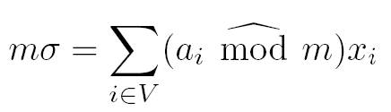
Dealing with Equality Constraints – Step 2
Introduce a new variable, σ, and produce the constraint

Slide 70
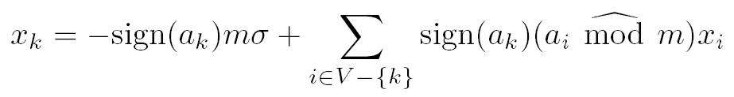
Dealing with Equality Constraints – Step 2
Finally

Slide 71
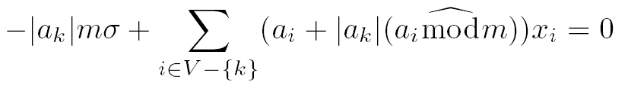
Dealing with Equality Constraints
Substitute this into all the constraints.
In the original constraint, this produces
Note:

Slide 72
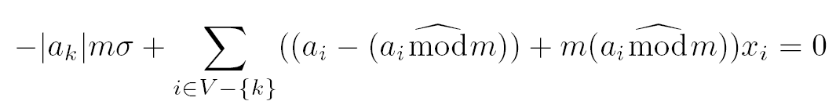
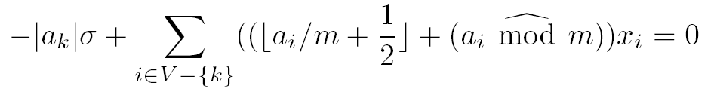
Dealing with Equality Constraints
Since |a_{k}| = m – 1, this is equal to
Now all terms are divisible by m, therefore
A handle on scaling

Slide 73
Dealing with scaling issue
In the original constraint
The absolute value of the coefficient of σ is the same as the absolute value of the original coefficient of x_{k}.
For all other variables, the absolute value of coefficients are reduced to at most two-thirds of their previous value.
Repeated applications of this rule will eventually force a unit coefficient to appear and allow us to eliminate the constraint.

Slide 74
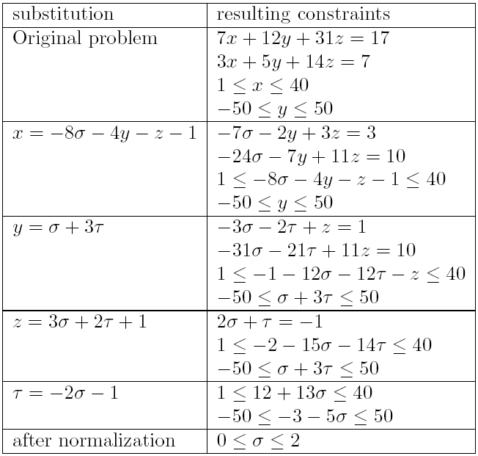
An Example
Unit coefficient
Constraint eliminated

Slide 75
An Example - cont
Integer solutions:
σ = 0, τ = −1, z = −1, y = −3, x = 12
σ = 1, τ = −3, z = −2, y = −8, x = 25
σ = 2, τ = −5, z = −3, y = −13, x = 38

Slide 76
Now on to inequality constraints
Converted equality constraints to inequalities
Process inequalities
Do simplication
Use modified Fourier-Motzkin

Slide 77
Simplifications
Check for contradictory constraints
Eg. 3x + 5y > 2 and 3x + 5y < 0
Contradiction implies problem has no solutions
Check for tight constraints
Eg. 6 ≤ 3x + 2y and 3x + 2y ≤ 6
Replace with equality constraint and repeat the previous step in eliminating equality constraints

Slide 78
Simplifications
Check for redundant constraints
Eg. 3x + 5y > 2 and 3x + 5y > 0
Second constraint can be deleted
If the problem reduces to at most one variable and passes the test, then report that it has integer solutions

Slide 79
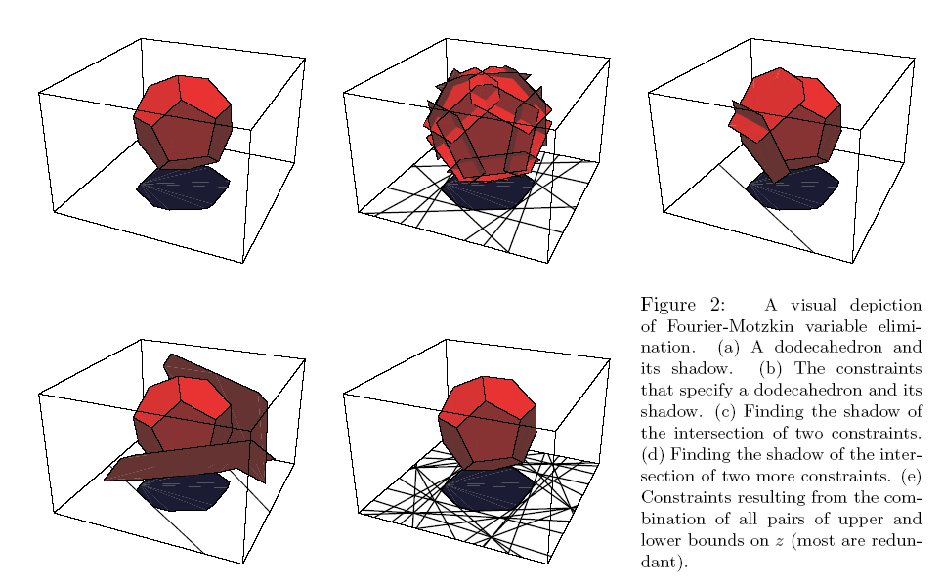
Getting real solutions
Use Fourier-Motzkin

Slide 80
Real Shadow
Given two constraints
β ≤ bz
az ≤ α
where a, b are positive integers, and α and β does not involve z
We combine to get
aβ ≤ abz ≤ bα
The constraint aβ ≤ bα is the real shadow of the intersection of the two constraints
z is projected away; the real shadow is a polytope in the subspace not involving z

Slide 81
Integer Shadow
Ideally we would like to have the integer shadow
Every point in the integer shadow corresponds to at least one integer solution
But this is hard to compute directly
Instead compute somewhere in between
the dark shadow

Slide 82
Searching for Integer Solutions – Dark Shadows
Suppose aβ ≤ bα has integer solutions but aβ ≤ abz ≤ bα do not
There is no multiple of ab between aβ and bα
The gap between aβ and bα is less than ab
There is no integer solution to z
Now, a, b are positive integers. Let i = ⎣β / b⎦. Then

Slide 83
Dark Shadow
As a consequence, we now have:
ab(i + 1) – bα ≥ b
Since bα < ab(i+1), both sides all integers, both sides multiples of positive integer b, the gap between both sides must at least be b
aβ – abi ≥ a
Similar argument

Slide 84
Dark Shadow
ab(i + 1) – bα ≥ b and aβ – abi ≥ a implies
(ab(i + 1) – bα) + (aβ – abi) ≥ b + a
But
ab(i + 1) – abi = ab
Implies
ab – bα + aβ ≥ b + a
Implies
bα – aβ ≤ ab – a – b

Slide 85
Dark Shadow
In other words, if aβ ≤ abz ≤ bα do not have integer solution, then bα – aβ ≤ ab – a – b + 1
Conversely, if bα – aβ ≥ ab – a – b + 1 = (a – 1)(b – 1), then an integer solution to z must exist

Slide 86
Dark Shadow
The dark shadow for β ≤ bz and az ≤ α is
bα – aβ ≥ (a – 1)(b – 1)
If a = 1 or b = 1, the dark shadow and the real shadow are identical
bα – aβ ≥ 0 ⇒ aβ ≤ bα
If the dark and real shadows of every combination of upper and lower bounds are identical, the projection is said to be exact
This will happen if all the coefficients of z in the lower bounds are one or if all the coefficients of z in the upper bounds are one

Slide 87
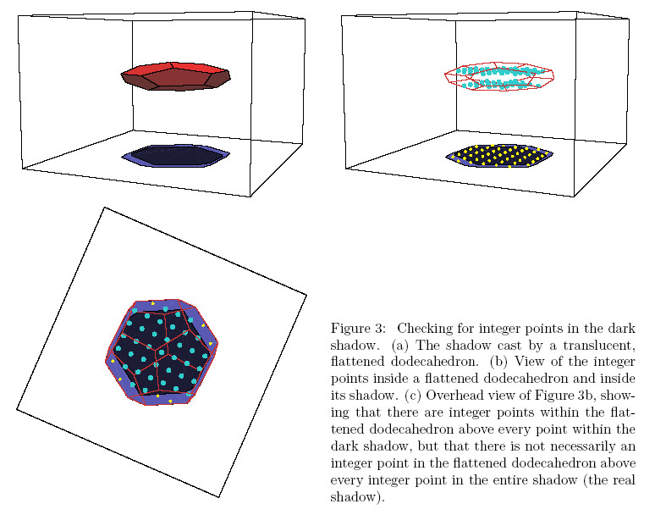
Dark Shadow

Slide 88
The Omega Test
First decide which variable to eliminate. Choose a variable so as to perform an exact projection if possible, and to minimize the number of constraints resulting from the combination of upper and lower bounds. If we are forced to perform non-exact reductions, we choose a variable with coefficients as close to zero as possible.

Slide 89
The Omega Test
Compute the real and dark shadows of the set of constraints along this variable
If the dark and real shadows are identical, there are integer solutions to the original set of constraints if and only if there are integer solutions to the shadow

Slide 90
The Omega Test
Otherwise
(a) If there are no integer solutions to the real shadow, then there are no integer solutions to the original constraints
(b) If there are integer solutions to the dark shadows, then there are integer solutions to the original constraints

Slide 91
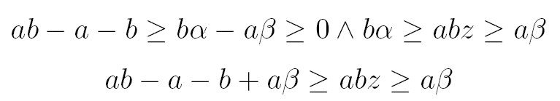
The last and expensive case
(c) If there exists an integer solution to the original set of constraints, there must exist a pair of constraints β ≤ bz and az ≤ α such that

Slide 92
The last and expensive case (contd)
(Exhaustive search - rare)
To check this, determine the largest coefficient of a of z in any upper bound of z, and, for each lower bound bz ≥ β on z, test if there are integer solutions to the original problem combined with bz = β + i for each i such that (ab – a – b) / a ≥ i ≥ 0

Slide 93
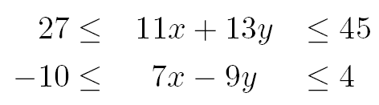
A Nightmare Example
Consider:
No exact projection
Choose to eliminate x since the coefficients are smaller

Slide 94
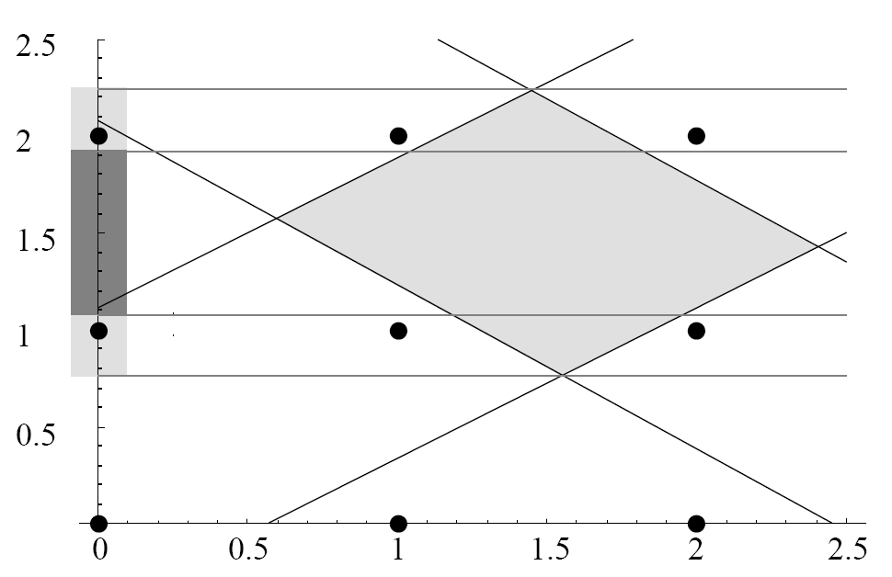
A Nightmare Example
You can’t have a point here – it won’t be integer
Dark shadow does not contain integer solutions
Real solution
Space
Real shadow contains integer solutions

Slide 95
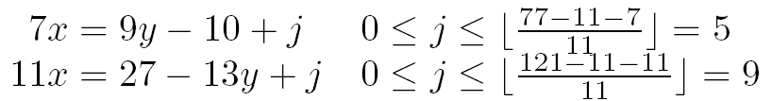
A Nightmare Example
Check the intersection of the original set of constraints and any one of the following constraints to see if it contains an integer solution

Slide 96
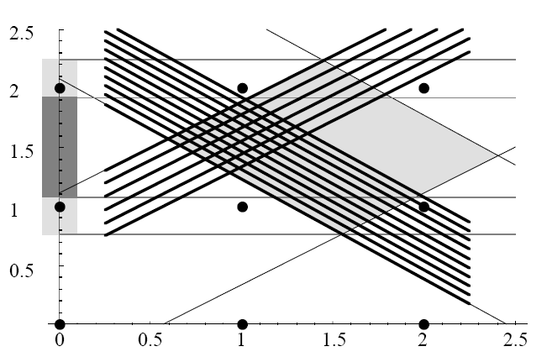
A Nightmare Example
Scan!

Slide 97
Loop Transformations

Slide 98
Motivation
Motivation: restructure program so as to enable more effective back-end optimizations and hardware
exploitation
Loop transformations are useful for enhancing
register allocation
instruction-level parallelism
data-cache locality
vectorization
parallelization

Slide 99
Effects of Loop Transformations
DO I = 1, M
DO J = 1, N
S: A(I,J) = …
T: ... = … A(I,J-1)…
END DO
END DO
DO J = 1, N
DO I = 1, M
S: A(I,J) = …
T: ... = … A(I,J-1)…
END DO
END DO

Slide 100
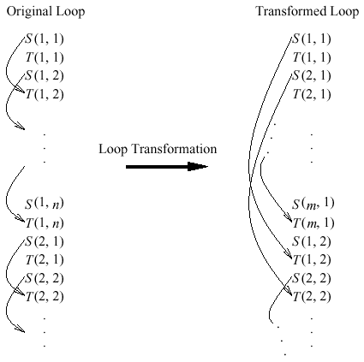
Effects of Loop Transformations

Slide 101
Unimodular Loop Transformations
Loop Interchange
Loop Reversal
Loop Skewing

Slide 102
Loop Interchange: Definition
Before interchange: After interchange:
DO i_1 = … DO i_P(1) = …
. .
. .
DO i_n = … DO i_P(n) = …
B(i_1,…,i_n) B(i_1,…,i_n)
where P is a permutation of 1…n.
Original loop order = i₁,…,i_{n}
Permuted loop order = i _{P(1)},…,i _{P(n)}

Slide 103
Example of Loop Interchange for Enabling Loop-Invariant Code Motion
Before: DO i=1, n
DO j=1, n
W(i,j)= X(i,j)+Y(j)+Z(j)
END DO
END DO
After: DO j=1, n
DO I=1,n
W(i,j) = X(i,j)+Y(j)+Z(j)
END DO <------->
END DO loop-variant expression

Slide 104
Loop Interchange: Legality
Two loops in a double loop may be interchanged if and only if it does not contain any dependency with a direction vector (<, >)
For a level m tightly nested loop, if there exist a direction vector of the form
then we cannot interchange the adjacent loop L_{p} and L_{p+1} without affecting correctness

Slide 105
Loop Interchange: Legality
For a level m tightly nested loop, if all the direction vectors are of the form
then we may interchange the loops L_{p} and L_{q} so long as p < q

Slide 106
Loop Interchange: Legality
Control Dependence: If loop body B contains a
premature loop exit, then any non-identity permutation is illegal.
Loop Bounds: If the bounds for loop i_{k} contains an
unanalyzable function of index variable i_{j}, where j<k, and if P(j)<P(k), then loop interchange in illegal.

Slide 107
Example of Legal Loop Interchange
DO i=1, n-1
DO j=2, n-1
X(i,j)=X(i-1,j)+Y(i,j)
END DO
END DO
Consider loop interchange with permutation P=[2,1]
Original data dependence vectors = {(0,1)}
Permuted data dependence vectors = {(0,1)}

Slide 108
Example of Illegal Loop Interchange
DO i=2, n-1
DO j=2, n-1
X(i,j)=X(i-1,j+1)+Y(i,j)
END DO
END DO
Consider loop interchange with permutation P=[2,1]
Original data dependence vectors = {(1,-1)}
Permuted data dependence vectors = {(-1,1)}

Slide 109
Example of Illegal Loop Interchange (contd.)
Original iteration space:
Transformed iteration space:
i
j
3
[3,1]
[3,2]
[3,3]
[3,1]
[3,2]
[3,3]
3
2
[2,1]
[2,2]
[2,3]
[2,1]
[2,2]
[2,3]
2
1
[1,1]
[1,2]
[1,3]
[1,1]
[1,2]
[1,3]
1
j
i
1
2
3
1
2
3
Dependence Vector = (1,-1)
Dependence Vector = (1,1)

Slide 110
Loop Reversal
Instead of going from say 1 to N, we reverse the loop such that the iterations go from N to 1
Can only be done if there are no loop carried dependences
Useful in combination with other loop optimizations

Slide 111
Loop Reversal: An Example
DO I = 1, N
C(I) = A(I) + B(I)
END DO
DO I = 1, N
D(I) = C(I+1) * 3.14
END DO
DO I = N, 1, -1
C(I) = A(I) + B(I)
D(I) = C(I+1) * 3.14
END DO

Slide 112
Loop Skewing
Loop skewing is the changing of the iteration vector from a form such as (i, j) to (i, j + f × i), i.e. the other loop’s index is scaled by an integer and then added to the inner loop’s
All distance vectors are changed from (d_{i}, d_{j}) to (d_{i}, d_{j} + f × d_{i})
Enables other loop transformations

Slide 113
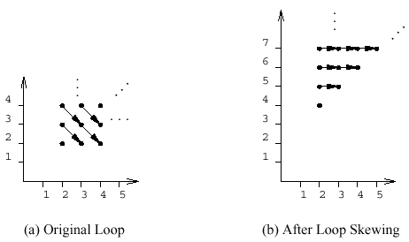
Effect of Loop Skewing

Slide 114
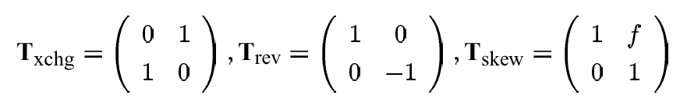
Unimodular Transformation
All the 3 loop transformation can be modelled by unimodular matrices
For a double loop:
For example, loop interchange

Slide 115
Other Loop Transformations
Loop Unrolling
Loop Distribution
Loop Tiling
Etc., etc., etc.,

Slide 116
Loop Unrolling
Create a constant multiple copy of the loop body
Enlarge the loop body and provide for more opportunities for parallelism
A prologue (or epilogue) is need to take care of the “remainder” of the loop
Essentially the original loop with adjusted loop bounds
Can lead to code explosion

Slide 117
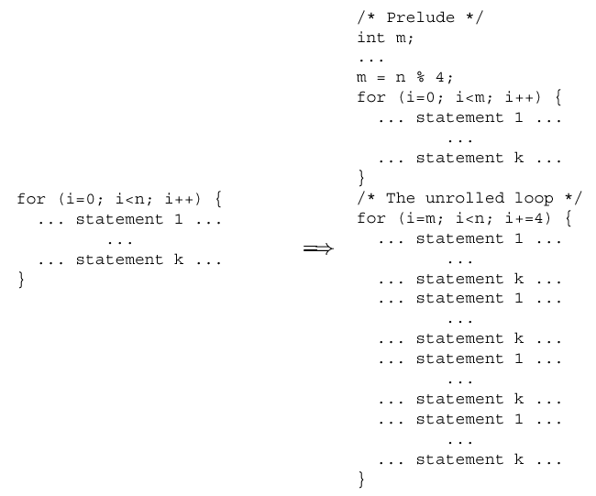
Loop Unrolling

Slide 118
Loop Distribution: Definition
DO i = . . .
B1(i)
END DO
Do i = . . . .
B(i) .
END DO .
DO i = . . .
Bk(i)
END DO
Original loop body = B
Distributed loop bodies = B₁,…, B_{k}
(need not appear in same order as in _{B})

Slide 119
Example of Loop Distribution for Eliminating Register Spills
Suppose only two floating-point registers were
available for allocation:
DO i = 1, n
R = R + X(i)
Do i = 1,n END DO
R = R + X(i) DO i=1, n
S = S + Y(i) S= S + Y(i)
T = T + Z(i) END DO
END DO DO i = 1, n
T = T + Z(i)
END DO
# f.p. regs needed = 4 # f.p. regs needed = 2

Slide 120
Loop Distribution: Legality
Loop distribution is legal iff no pair of distinct distribution loop bodies, B_{i} and B_{j}, is connected by a cycle of data and control dependencies in the original loop body, B.

Slide 121
Example of Legal Loop Distribution
DO i = 1, n
X(i) = X(i-1)+Y(i)
Do i = 1,n END DO
X(i) = X(i-1)+ X(i)
Y(i) = X(i)+1 DO i=1, n
END DO Y(i) = X(i)+ 1
END DO

Slide 122
Example of Illegal Loop Distribution
DO i = 1, n
X(i) = X(i-1) + Y(i-1)
Do i = 1,n END DO
X(i) = X(i-1)+ Y(i-1)
Y(i) = X(i)+1 DO i=1, n
END DO Y(i) = X(i)+ 1
END DO

Slide 123
Loop Distribution across Data Dependences
Self-cycles on distributed loop bodies can be ignored
Data dependences carried by outer loops can be ignored
Anti and output data dependences can be eliminated by storage duplication and data copying

Slide 124
Loop Distribution across Control Dependences
Distribution across loop-carried control dependence requires creation of temporary to store iteration count before loop exit
Distribution across loop-independent control dependence requires storing predicate values in mask array or replicating the predicate computation in distributed loop bodies
A conservative approach to deal with control dependences is to add dummy reverse control dependence edges when testing for loop distribution legality

Slide 125
Loop Distribution: Definition
DO i = . . .
B1(i)
END DO
. Do i = . . .
. B(i)
. END DO
DO i = . . .
Bk(i)
END DO
Original loop bodies = B₁,…B_{k}
Fused loop body = B

Slide 126
Example of Loop Fusion for Improved Register Locality
DO i = 1, n
X(i) = Y(i)+Z(i)
END DO DO i = 1,n X(i) = Y(i) + Z(i)
Y(i) = X(i) + Z(i)
DO i = 1, n END DO
Y(i) = X(i) + Z(i)
END DO
COST = 4n loads, 2n stores, Cost = 2n loads,2n stores

Slide 127
Loop Fusion: Legality
Loop fusion is legal if and only if
1. Original loops are adjacent (or can be made adjacent), and
2. Original loops have conformable loop bounds, and
3. None of the original loops has a premature loop exit, and
4. Fusion does not create a lexicographically negative loop-carried data dependence vector between loop body B_{i} and loop body B_{j}, i<j

Slide 128
Example of Legal Loop Fusion
DO i = 1, n
X(i) = X(i-1)+Y(i)
END DO DO i = 1,n X(i) = X(i-1)
+ Y(i)
Y(i) = X(i) + 1
DO i = 1, n END DO
Y(i) = X(i) + 1
END DO

Slide 129
Example of Illegal Loop Fusion
DO i = 1, n
X(i) = X(i-1)+Y(i-1)
END DO DO i = 1,n X(i) = X(i-1)
+ Y(i-1)
Y(i) = X(i) + 1
DO i = 1, n END DO
Y(i) = X(i) + 1
END DO

Slide 130
Unrolling of Innermost Loop: Definition
DO i=lo, hi-(R-1),R
DO i=lo,hi,1 (unroll R times) B(i)
B(i) --------------> . . .
END DO B(i+R-1)
END DO
DO i=i, hi, 1
B(i)
END DO
Original loop body = B(i)
R unrolled copies of loop body = B(i),…,B(i+R-1)
Unrolling of innermost loop is always legal

Slide 131
Example of Loop Unrolling for Improved Instruction-Level Parallelism
Before unrolling: After 2x unrolling:
DO i=1, n-1, 2
DO i=1, n, 1 W(i)=X(i)+Y(i)+Z(i)
W(i)=X(i)+Y(i)+Z(i) W(i+1)=X(i+1)+Y(i+1)+Z(i+1)
END DO END DO
DO i=i, n, 1
W(i)=X(i)+Y(i)+Z(i)
END DO

Slide 132
Unrolling of Multiple Loops: Definition
DO i1=lo1, hi1-(R1-1),R1
DO i2=lo2,hi2-(R2-1),R2
DO i1=lo1,hi1 . . .
DO i2-lo2, hi2 B(i1,i2,…)
. . . . . .
B(i1,i2,...) ------> B(i1+R1-1,i2,…)
. . . B(i1,i2+1,…)
END DO . . .
END DO B(i1+R1-1,i2+1,…)
. . .
(Unroll loop i1 R1 times) . . .
(Unroll loop i2 R2 times) END DO
END DO

Slide 133
Example of Outer Loop Unrolling to Improved Common Subexpression Elimination
Before unrolling: After 2x unrolling of loop j:
DO j=1, n, 1 DO i=1, n-1, 2
DO i=1,n DO i=1,n
W(i,j)=X(i)+Y(j) W(i,j)=X(i)+Y(j)
END DO W(i,j+1)=X(i)+Y(j+1)
END DO END DO
END DO
DO j=j, n, 1
DO i=1,n
W(i,j)=X(i)+Y(j) END DO
END DO

Slide 134
Unrolling of Multiple Loops: Legality
Given a set of n perfectly nested loops i₁,…,i_{n}, it is
legal to unroll outer loop i_{n} if it is legal to permute loop
i_{j} to the innermost position i.e. if permutation
P = [1,…,j-1,j+1,…,n,j] is legal.

Slide 135
Loop Tiling: Definition
After tiling
DO ii_1=…
Before tiling: .
DO ii_n=…
DO i_1=… DO I_1=…
. .
DO i_n=… DO i_n=…
B(i_1,…,i_n) B(i_1,…,i_n)
Original loop nest has n loops, i₁,…,i_{n}
Tiled loop nest has 2n loops, ii₁,…,ii_{n},i₁,…i_{n}

Slide 136
Example of Loop Tiling for Improved Data Cache Locality
DO ii=1,n,B
DO jj=1,n,B
DO i=1,n DO i=ii, min(ii+B-1,n)
DO j=1,n DO j=jj, min (jj+B-1,n)
X(i,j)= Y(j,i)--------> X(i,j)=Y(j,i)
END DO END DO
END DO END DO
END DO
END DO
# cache misses #Cache misses~2*n*n/L
~n*n + n*n/L

Slide 137
Loop Tiling: Legality
Loop tiling is legal if and only if loops i₁,…,i_{k} are fully
permutable
Data Dependence: loop tiling is illegal if any element d_{j}
in a vector (d₁,…,d_{n})∈D contains a negative value
Control dependence: If loop body B contains a
premature exit, then tiling for n>1 loops is illegal.
Loop bounds: if the bounds for loop i_{k} contain an
unanalyzable function of index variable i_{j}, where j<k,
then loop tiling is illegal.

Slide 138
Loop Tiling Example (original data access pattern)
A(i,1:n) = B(1: n,i)
...
...
...
...
...
A(i,1)
A(i,2)
B(1:n,i)

Slide 139
Loop Tiling Example (transformed data access pattern)
A(ii:ii+T_{i}-1,jj:jj+T_{j}-1)) = B(jj:jj+T_{j}-1,ii:ii+Ti-1)
...
...
...
...
...
...
Ti
Ti
Tj
Tj

Slide 140
Code Generation

Slide 141
Code generation strategy
A process of intersecting the polyhedra and projecting it
Given a polyhedron P ⊆ ℙ×ℚ, where ℙ and ℚ are subspaces, the projection of P onto ℙ is deﬁned as π_{ℙ}P = {p ∈ ℙ | ∃q ∈ ℚ, (p, q) ∈ P }.

Slide 142
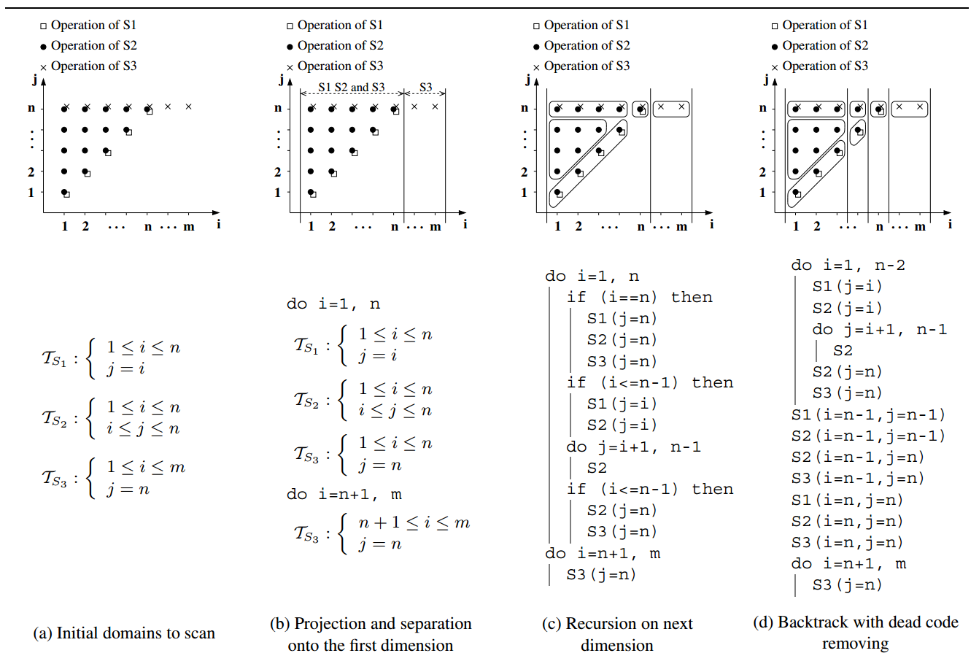
Code Generation (By Example)

Slide 143
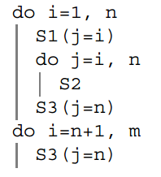
Final result

Slide 144
Quantifying Locality

Slide 145
Locality
Temporal locality
The same data location is accessed in different times (at close proximity)
Spatial locality
A neighbour of the current access is used in near future
Chances are this neighbouring data resides in the cache

Slide 146
Reuse
Self reuse
The temporal or spatial locality occuring within the same array reference
Group reuse
Reuse between different references to the same array

Slide 147
Kernel
Given a matrix, A. The set of solutions to vector x such that
Ax = 0
is called the kernel of A, written as ker(A). It is also called the null space of A.

Slide 148
Self-temporal Reuse
Consider a reference of X[Ai + c] in two different iterations of the loop, i₁ and i₂, say
Then there is self-temporal reuse if
Ai₁ + c = Ai₂ + c
⇒ A(i₁ – i₂) = 0
⇒ there is no self-temporal reuse
if the null space of A is empty

Slide 149
Loop carried reuse
We say that in a tightly nested loop, loop k carries reuse if given an access X[Ai + c] there is a vector d ∈ ker(A) such that d_{k} is the first non-zero element in d.

Slide 150
In practice
Self-temporal reuse occurs when A has zero coefficients in the kth column
An example:
A = i = c =
refers to the access X[I+2, I+3] – the J loop is not in the picture
1 0
1 0
I
J
2
3

Slide 151
Stride-1 Index
Multidimensional arrays are linearized in different ways according to the programming language
Fortran: column-major order
C: row-major order
Stride-1 indexing is that which walks through the linearized memory location sequentially

Slide 152
An Example
for I = 1 to M
for J = 1 to N
X[I, J] = Y[I] + Z[J]
Assume X is stored in row-major order, then J is the stride-1 index of X[I,J]
Z[J] is a stride-1 reference in the J loop
Y[I] is a stride-1 reference in the I loop and invariant in the J loop
Interchanging the two loops will result in Y[I] becoming stride-1 in the inner loop and Z[J] becoming invariant

Slide 153
Stride-1 dimension
That dimension of an access that corresponds to the sequential storage of the linearized array
Example: X[2I+3, I+J+3] is stored in row-major order is equiv. to X[Ai+c] where
A = i = c =
2 0
1 1
I
J
3
3
Stride-1 dimension

Slide 154
Self-spatial reuse
Spatial reuse occurs in the stride-1 dimension
They may be other spatial reuse
If we eliminate the stride-1 dimension from A, giving A_{s}, then there may be spatial reuse with distance d if A_{s}d = 0

Slide 155
Unit Normal Vector
e_{k} is a unit normal vector if
e_{k} =
0
.
.
.
0
1
0
.
.
.
0
k -1

Slide 156
More Self-spatial reuse
Spatial reuse occurs for loop k only if
e_{k} ∈ ker(A_{s}); and
The coefficient of the index variable for loop k in the subscript expression for the stride-1 dimension is smaller than the cache block
This occurs when the index variable for the kth loop appears only in the stride-1 dimension

Slide 157
Temporal Reuse Factor
For a loop k, the temporal reuse factor for the loop is
The trip count for the loop if e_{k} ∈ ker(A)
Otherwise, it is one

Slide 158
Spatial Reuse Factor
If e_{k} ∈ ker(A_{s}), the spatial reuse factor is max(1, b / a_{sk})
b is the size of a cache block
a_{sk} is the coefficient of the index variable for loop k in the stride-1 dimension s
The spatial reuse factor is one otherwise

Slide 159
Self-Reuse Factor
The self-reuse factor, R_{k}, for loop k is equal to the temporal reuse factor if it is greater than one, otherwise it is the spatial reuse factor
The cumulative self-reuse, , factor for a reference in loop k is the product of all self-reuse factors for that reference in loop k and all inner loops containing the reference

Slide 160
Cumulative Reuse Factor
It measures how often an array element will be reused inside each loop
It is also a measure of the references that will be satisfied by the cache

Slide 161
Data Footprint
The data footprint of a reference is the number of cache blocks that will be brought into the cache by a particular loop
If there is no reuse, then each iteration will bring in the cache block containing the element. So if N_{k} is the trip count of loop k, this will be b × N_{k}.

Slide 162
Data Footprint
If there is reuse, then the footprint at level k out of n nested loop is:

Slide 163
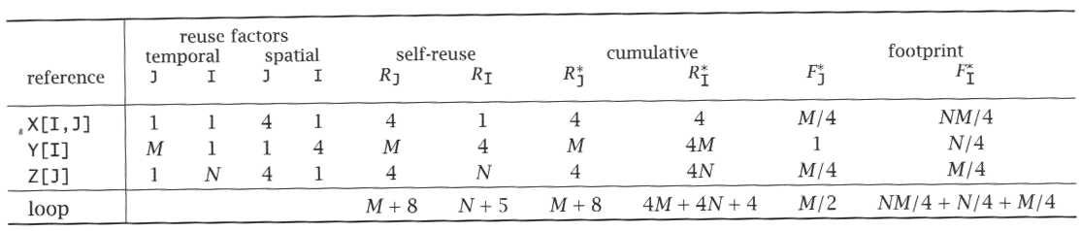
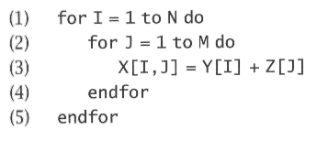
An Example

Slide 164
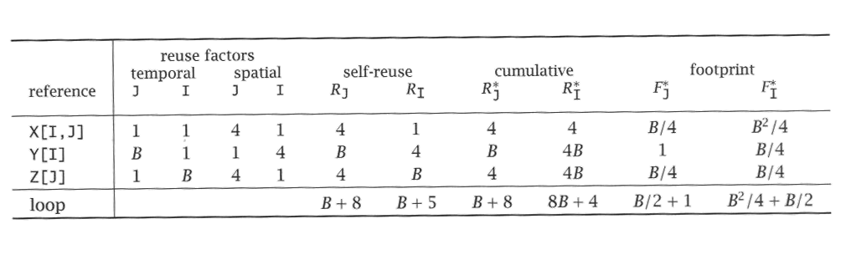
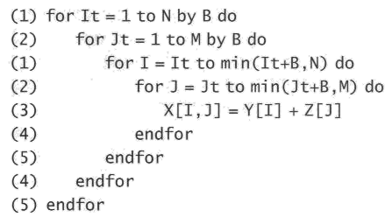
Tiled Example

Slide 165
Vector Spaces
Let V = {v₁, …, v_{m}} be a finite set of real n-vector over ^{n}.
A linear combination of vectors of V is given by
x = α₁v₁ + … + α_{m}v_{m}
where α_{i} are real numbers.
V is linearly dependent if there exists a linear combination that results in the zero vector with one or more α_{i} being non-zero. Otherwise V is linearly independent.

Slide 166
Dimensionality and Basis
The dimensionality of a set of vectors V, written as dim(V), is the number of linearly independent vectors in V
A basis for a n-dimensional vector space is a set of n linearly independent vectors such that every point in the vector space can be expressed as a linear combination of vectors of the basis
{e_{k} : 1 ≤ k ≤ n} is the basis for ^{n}

Slide 167
Subspace
Let V be a set of vectors. The subspace spanned by V, written span(V), is the subset of ^{n} such that:
V ⊆ span(V)
x, y ∈ span(V) ⇒ x + y ∈ span(V)
x ∈ span(V) and α ∈  ⇒ αx ∈ span(V)

Slide 168
Degree of Reuse
There may be reuse within a loop nest but not in a single loop index
The degree of reuse for temporal locality of a loop nest at level k is
= dim(span(e_{k}, e_{k+1}, …, e_{n}) ∩ ker(A))

Slide 169
Degree of Footprint
The degree of footprint is dim(A) –
These generalizes reuse and footprint
For spatial locality, we use A_{s} instead of A as before

Slide 170
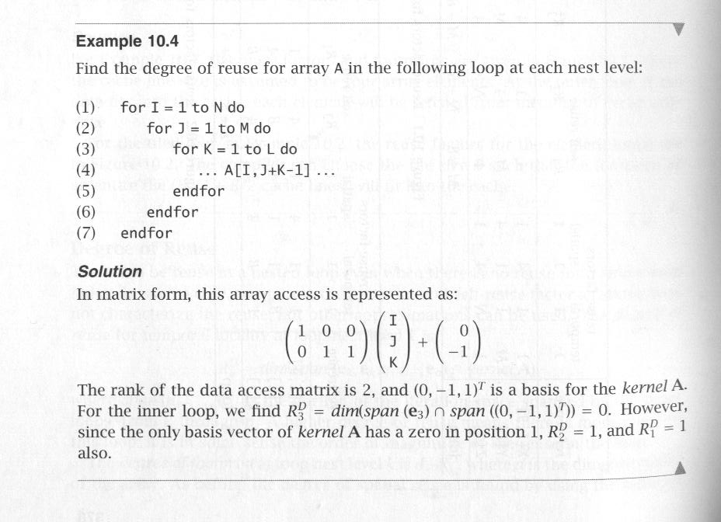
An Example

Slide 171
Multiple References
There may be reuse between difference references – group reuse
Will only consider references with the same data access matrix, i.e. X[Ai + c₁] and X[Ai + c₂]

Slide 172
Group-Temporal Reuse
There is temporal reuse if Ad = A(i₁ – i₂) = c₁ – c₂
The set of all solutions, {d}, is d + x, where d is a particular solution and x ∈ ker(A)
Interested in those d·x = 0 for all x ∈ ker(A)

Slide 173
Group-Temporal Reuse Factor
If d = 0, the group temporal reuse factor is ∞
Otherwise, let k be the first non-zero entry in d, the group temporal reuse factor for the kth loop is N_{k} / d_{k} and one for all other loops

Slide 174
Group Spatial Reuse
Consider A_{s}, c_{s,1}, and c_{s,2} which are A, c₁, and c₂ with the stride-1 dimension removed
Solve for A_{s}d = c_{s,1} - c_{s,2}
As before, focus on those solutions where d·x = 0 for all x ∈ ker(A_{s})

Slide 175
Group Spatial Reuse Factor
Let s1 be the index of the stride-1 dimension
Given two references, the group spatial reuse factor are as follows:
If there is self-spatial reuse for the references, or if gcd(a_{s1,1}, …, a_{s1,n}) divides c_{1,s1} – c_{2,s1}, then it is one for all loops
If d = 0, the group spatial reuse factor is N_{k} for the innermost loop and one for all other loops
Otherwise, let d_{k} be the outermost nonzero element of d, the group spatial reuse factor for loop k is N_{k} / d_{k}, and one for all other loops

Slide 176
An Example
1 for I = 1 to N do
2 for J = 1 to M do
3 … X[I, J] …
4 … X[I+1, J] …
5 … X[I, J] …
6 … X[I, J-1] …
 |  | Self-spatial |  | Group-temp |  | Cumulative
line | reference | J | I | J | I | J | I
4 | X[I+1, J] | 4 | 1 | 1 | 1 | 4 | 4
3 | X[I, J] | 4 | 1 | 1 | N | 4 | 4N
5 | X[I, J] | 4 | 1 | ∞ | 1 | ∞ | ∞
7 | X[I, J-1] | 4 | 1 | M | 1 | 4M | 4M

Slide 177
The Polyhedral Model
The modern vocabulary
(as well as a summary)

Slide 178
Static Control Parts (SCoP)
A subclass of general loops nests that can be represented in the polyhedral model
Defined as a maximal set of consecutive statements, where loop bounds and conditionals are affine functions of the surrounding loop iterators and the parameters (constants whose values are unknown at compilation time).

Slide 179

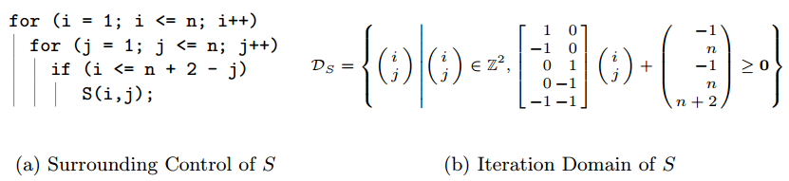
Iteration Domain
The Iteration Domain is the collection of points in the iteration space that result in a statement’s execution.

Slide 180
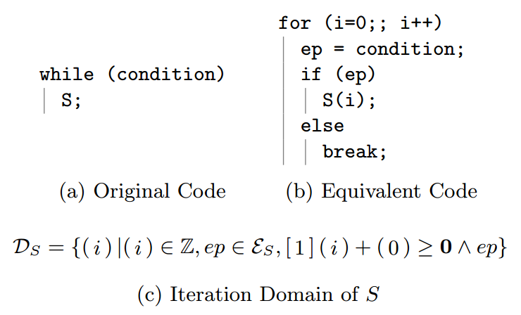
Variants
It is possible to have more complicated iteration domains

Slide 181
Scattering functions
A function of the following form that is defined over all points in the iteration domain
θ(x) = Tx + t

Slide 182
Two special class of scattering functions
Access functions are scattering functions that gives the memory locations accessed by iteration instances
Schedule functions are scattering functions that assigns a logical time of execution to iteration instances

Slide 183
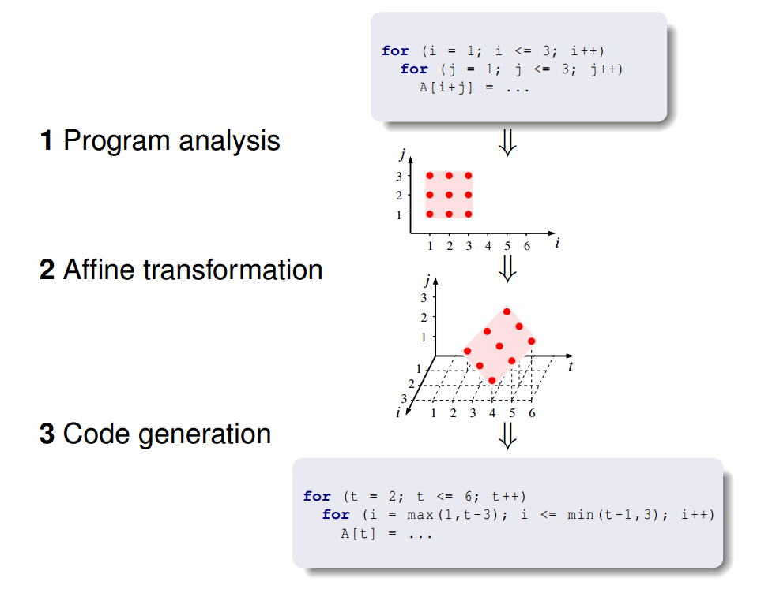
The Polyhedral Framework

Slide 184
Implementations
GCC
Graphite
PCP (Polyhedral Compilation Package)
CLOOG
LLVM
Polly

Slide 185
References
Randy Allen and Ken Kennedy, Optimizing Compilers for Modern Architectures. Morgan-Kaufmann 2001.
Michael Wolfe, High Performance Compilers for Parallel Computing. Addison-Wesley 1996.

